Slide 1
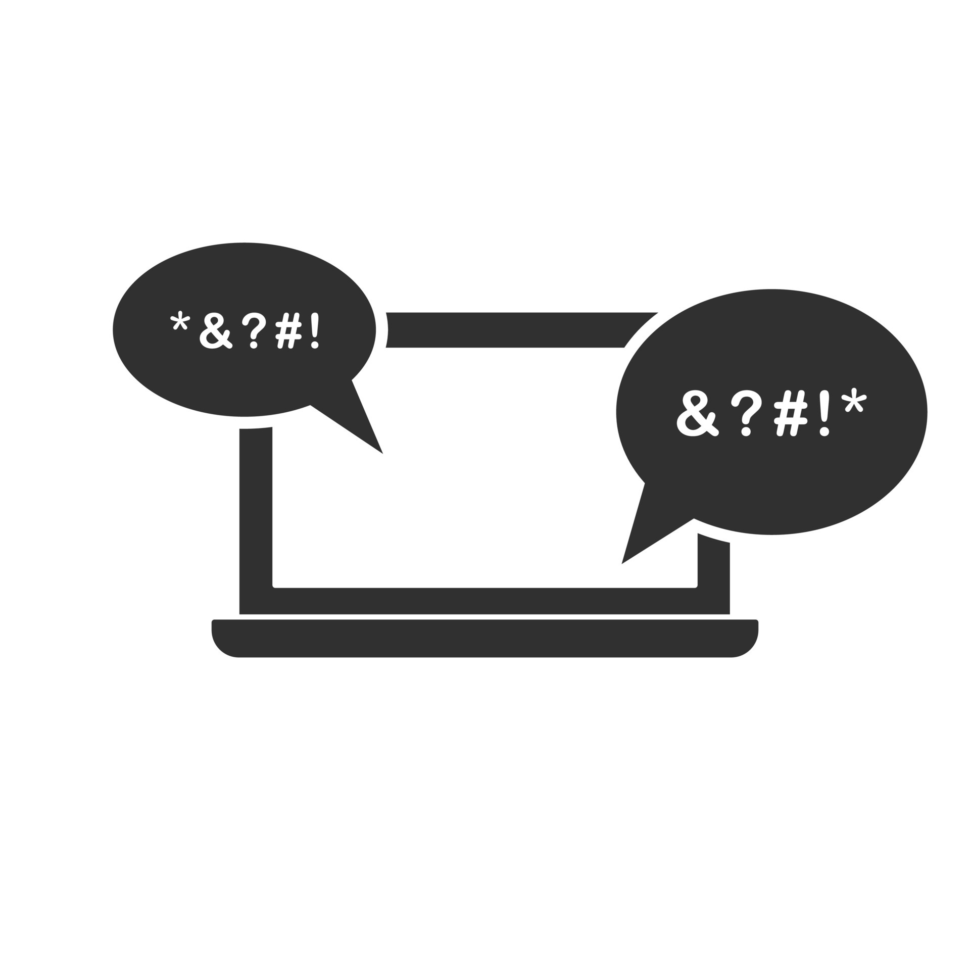
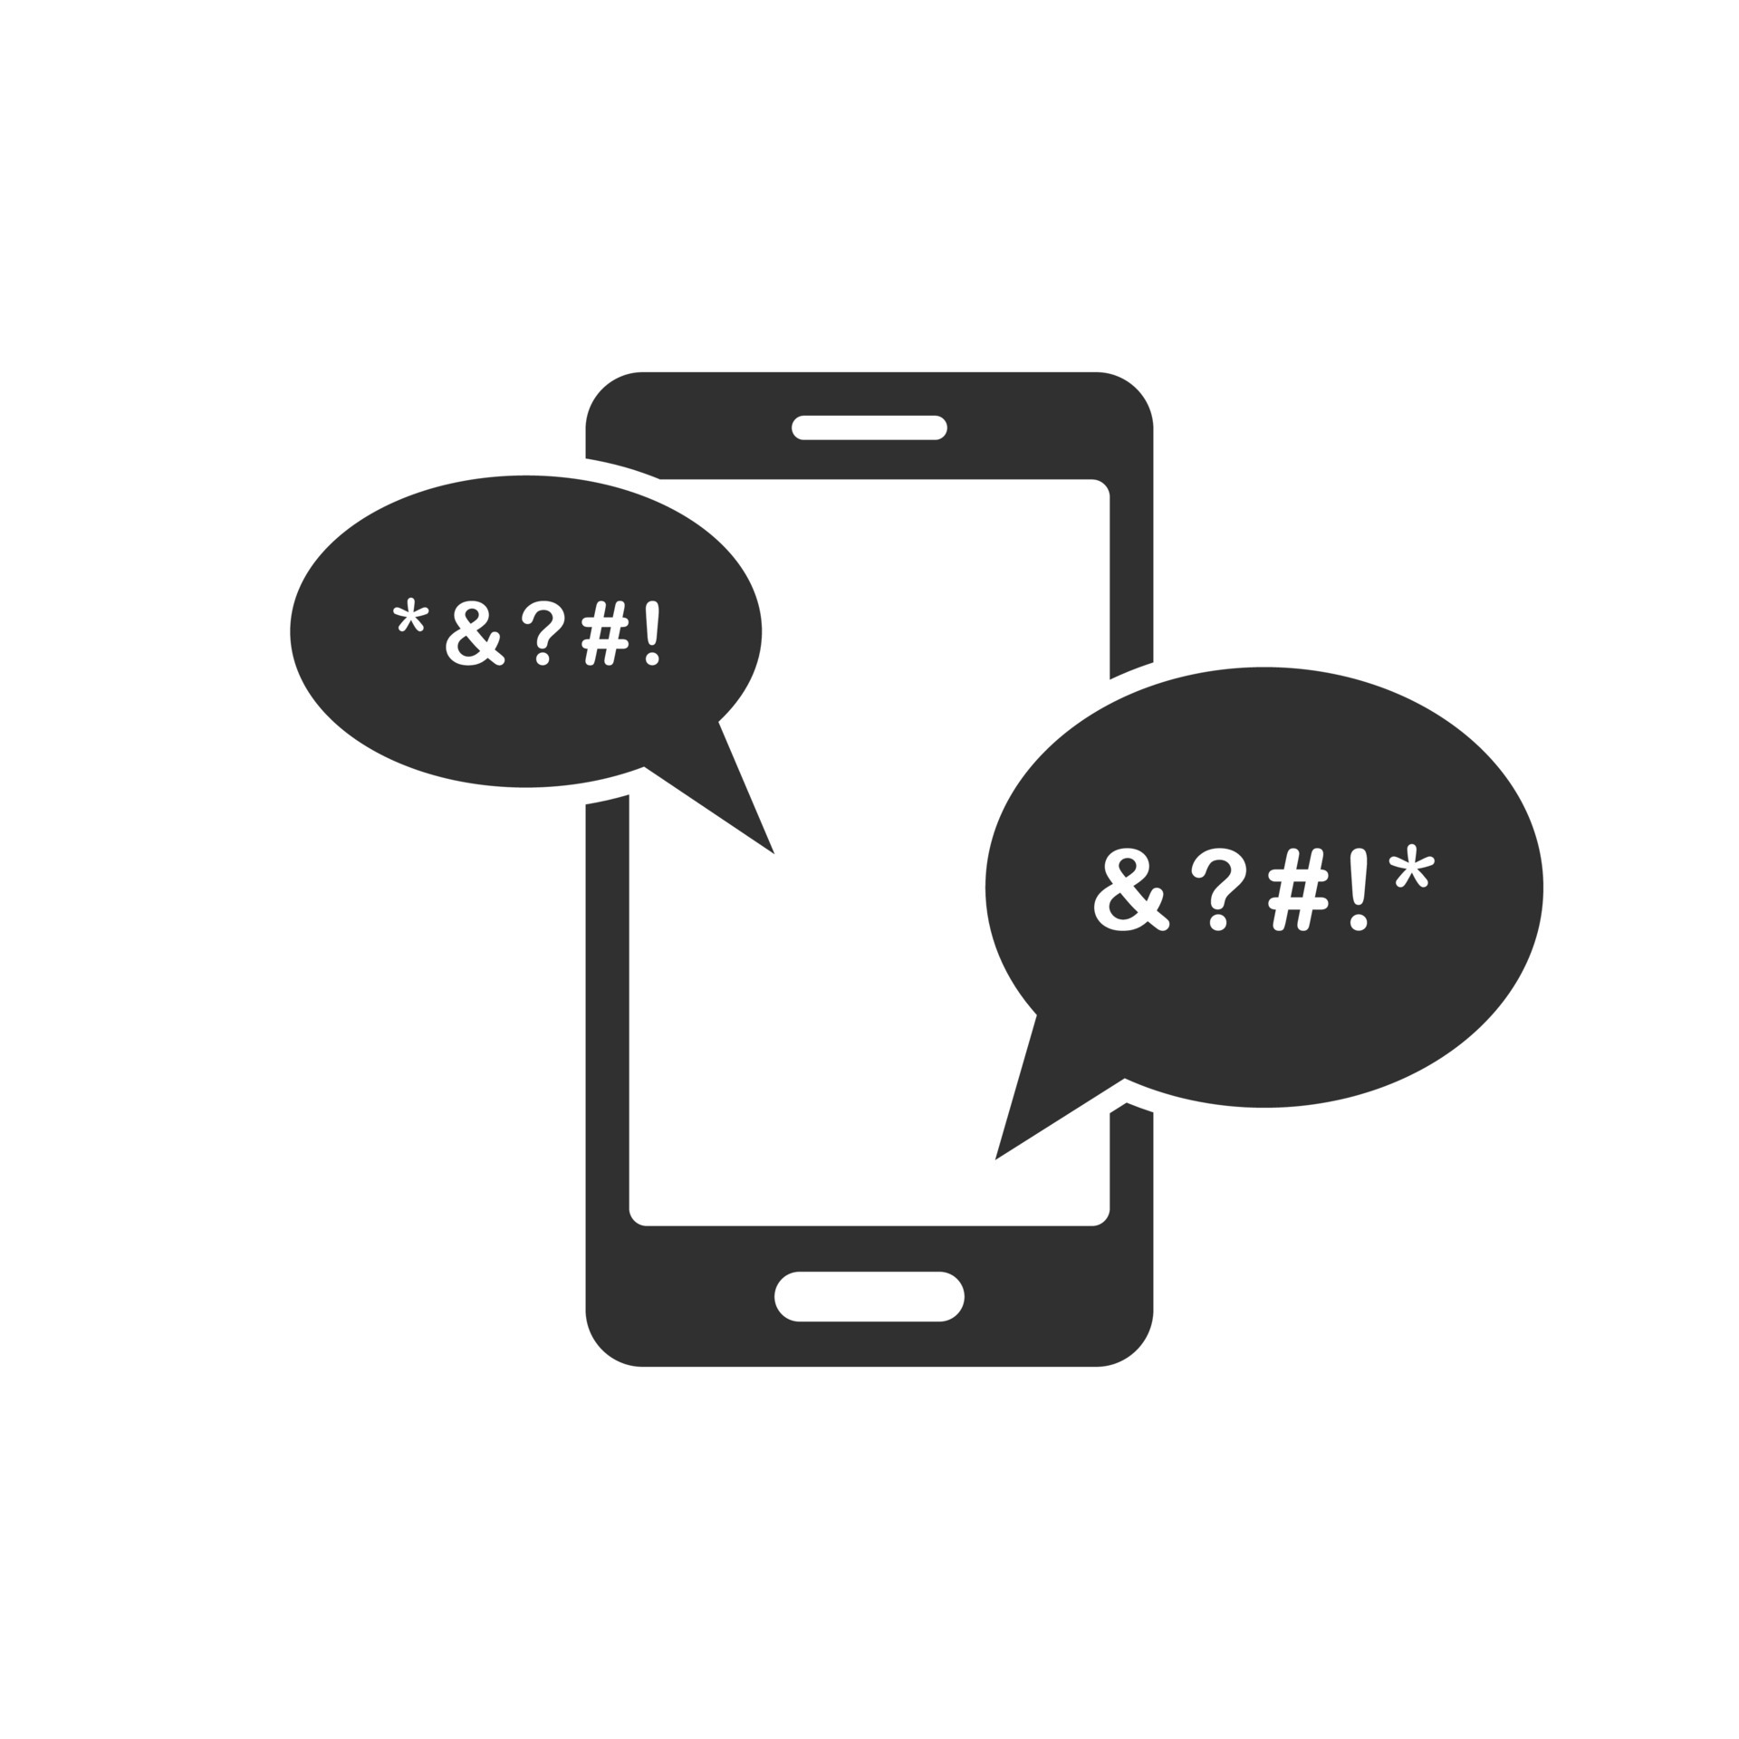
FLAGGING CYBERBULLYING on twitter for Be Kind Org.
SABINA BAINS
August 2022

Slide 2
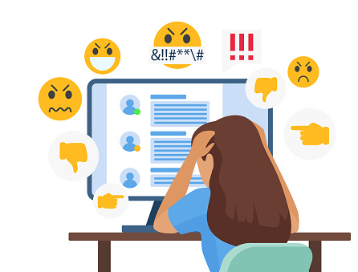
BUSINESS objective
With the possibility of Twitter removing it’s moderating practices, many fear incidents of hate speech and misinformation will skyrocket
BeKind Org. would like to create a browser extension with the ability to flag potentially harmful tweets
BeKind Org. needs our help creating an algorithm that will accurately flag instances of cyberbullying in tweets

Slide 3
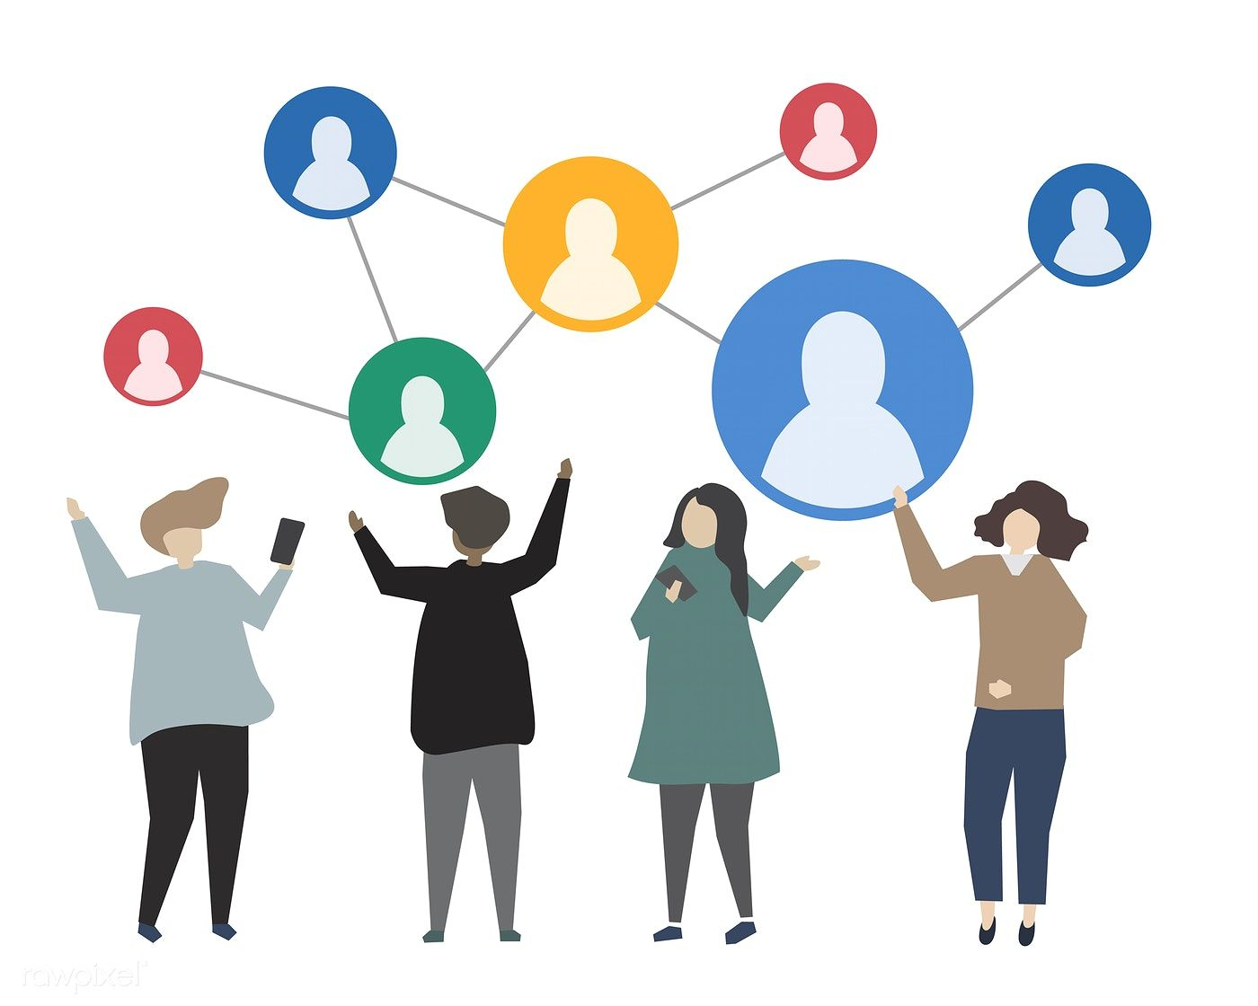
Our solution
Use a supervised learning approach
Utilizing real tweets that have already been manually flagged by type of cyberbullying
Alter the data due to Natural Language Processing, which gives computers the ability to understand text and spoken words in the same way human beings can.
Train dataset using Neural Networks, an algorithm inspired by the biological neural networks that constitute the human brain
Data source: https://www.kaggle.com/code/anayad/classifying-cyberbullying-tweets/data

Slide 4
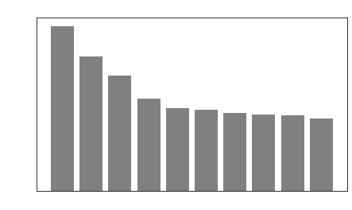
DATA exploration and processing
Frequency Distribution Of Top Words Used in Cyberbullying Tweets
Data used for prediction consists of 47K tweets labeled according to the class of cyberbullying:
Age
Ethnicity
Gender
Religion
Other types of cyberbullying
Not cyberbullying
Because this analysis requires Natural Language Processing, we must standardize the words in each tweet and remove unimportant words
“Connect”, “Connecting”, “Connected” will all become “connect”
Words such as “The”, “a”, “and” etc. will be removed
Data source: https://www.kaggle.com/code/anayad/classifying-cyberbullying-tweets/data

Slide 5
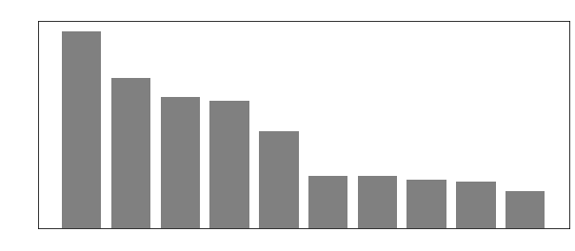
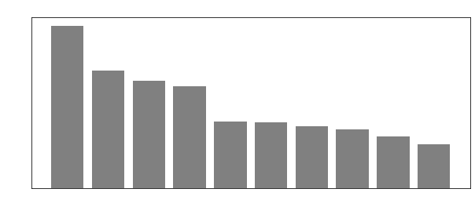
DATA exploration and processing
For most of our cyberbullying categories, the most common words in the associated tweets were unique from each other
“Not Cyberbullying” and “Other Cyberbullying” had a high overlap in word usage
More complex modeling such as neural networks is needed so our model can understand the order of words used
Data source: https://www.kaggle.com/code/anayad/classifying-cyberbullying-tweets/data

Slide 6
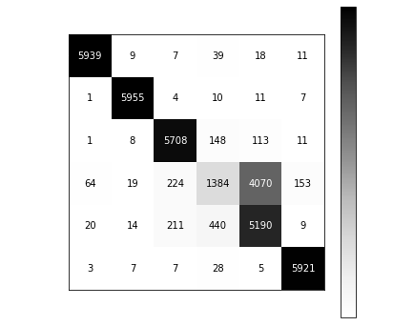
Evaluation of Final model
Matrix of True and Predicted Values
Overall, our model predicted the correct label 82% of the time
While our different classifications of bullying performed well, the model had a difficult time classifying “other” types of cyberbullying with non-bullying
This model correctly predicted non-bullying tweets 32% of the time, most were incorrectly predicted as “other”
Data source: https://www.kaggle.com/code/anayad/classifying-cyberbullying-tweets/data

Slide 7

Recommendations / next steps
Implement this model as a starter for the browser extension, continue to gather data to improve accuracy in models
Cyberbullying not related to age, race, gender, or religion is harder to identify, either remove the “other” category or increase our testing data
Include a flag for tweets with misleading or incorrect data articles, as the rise in these types of tweets can also negatively affect users

Slide 8
Thank you
Sabina Bains
Email: Sabinabains3@gmail.com
LinkedIn:
https://www.linkedin.com/in/sabina-bains-a58645a6/

